Slide 1
GreenRoute: Real-Time Web-Based Bus Tracking System
Project Code: BSCS-AWM-153435-2025
Project Manager: Prof. Dr. Muhammad Ilyas
Supervisor: Dr. Hussam Ali
Team:
Asma Khanum (TL)
Mahnoor (TM)
Wajeeha Safdar (TM)

Slide 2
TABLE OF CONTENTS
01
02
03
Introduction & Problem Statement
Proposed Solution (GreenRoute)
Project Scope & Limitations
04
05
06
Functional & Non-Functional Requirements
Assumption & Dependencies
System Architecture & Dataflow
07
08
09
Sequence Logic & Synchronization
Technical Risks & Mitigation
Technology Stack
10
11
Conclusion & Future Scope
User Interface Mockup

Slide 3
01
Introduction & Problem Statement

Slide 4
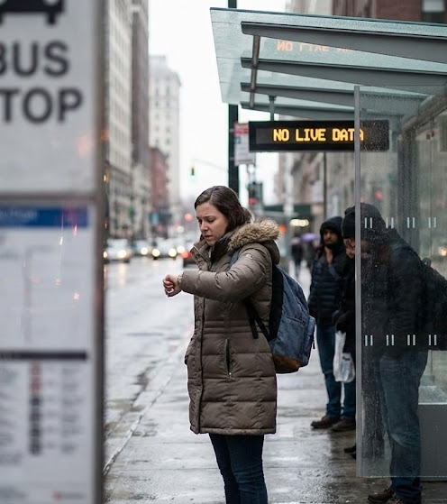

The "Blind Spot" in Public Transport
Uncertainty: Passengers have zero visibility of bus locations, causing anxious waiting.
Inefficiency: Students waste 15–20 minutes daily at stops.
Manual Management: Administration relies on phone calls to track drivers.
Goal: Eliminate the wait gap using real-time digital tracking.

Slide 5
02
Proposed Solution Overview

Slide 6
GreenRoute System Overview
A Progressive Web Application (PWA) connecting Drivers, Students, and Admins.
Live GPS tracking visualized on Google Maps.
No installation required; works on any smartphone browser.
Passenger View: Live Map + ETA.
Driver View: One-tap location broadcasting.
Admin Panel: Fleet management.

Slide 7
03
Project Scope & Limitations

Slide 8
Scope & Limitations
In-Scope (Deliverables)
Out-of-Scope (Limitations)
Live Fleet Tracking: Real-time telemetry for the newly launched fleet of 33 E-Buses in Sargodha.
Cross-Platform Accessibility: Progressive Web App (PWA) fully integrated with Google Maps API.
Role-Based Access Control (RBAC): Distinct security layers for Admins (Fleet Managers) and Drivers.
Automated Fare Collection: Digital ticketing and payment gateway integration.
Native Mobile Development: Dedicated Android (.apk) or iOS (.ipa) applications.
Offline Functionality: System requires active Internet/GPS connectivity to transmit data.

Slide 9
Scope & Limitations
In Scope: Real-time tracking for 33 E-busses launched by cm maram nawaz
Responsive PWA with Google Maps integration.
Role-Based Access Control (Admin vs Driver).
Out of Scope: Digital ticketing and payments.
Native Android/iOS apps excluded.
Offline operation not supported.

Slide 10
04
Functional & Non-Functional Requirements

Slide 11
Functional Requirements
Register new users (Passenger, Driver, Admin).
Secure user login using email and password.
Display real-time bus locations on Google Maps.
Show bus details such as bus number, route, and ETA.
Allow drivers to start and stop trip tracking.
Enable drivers to share live GPS coordinates.
Allow administrators to add, update, or remove buses and routes.
Provide an admin dashboard to monitor buses and drivers.

Slide 12
Functional Requirements
Synchronize location updates in real time using Firebase.
Allow users to search buses and routes.
Display complete route information with major stops.
Show live bus movement without page refresh.
Ensure responsive design for mobile and desktop.
Restrict access to admin and driver-only features.
Log basic system activities for monitoring.

Slide 13
Non-Functional Requirements
Performance Requirements:
System must be responsive with minimal user interaction delay.
Real-time location updates with minimal lag.
Smooth integration between tracking, maps, and admin modules.
Support multiple concurrent users without performance loss.
Maintain acceptable page load times under normal network conditions.

Slide 14
Non-Functional Requirements
Safety Requirements:
Ensure reliable data transmission without loss or corruption.
Automatically resume updates after network or GPS failure.
Stop driver tracking automatically when trip ends.
Ensure the system does not distract drivers during operation.
Implement backup and recovery mechanisms.
Follow institutional safety and data handling policies.

Slide 15
Non-Functional Requirements
Security Requirements:
Encrypt all communication using HTTPS.
Use Firebase Authentication for user access control.
Securely store passwords and personal data.
Restrict bus and route management to authorized admins only.
Prevent exposure of sensitive driver or route data.
Automatically log out inactive users.
Comply with institutional and Google Cloud privacy policies..

Slide 16
Non-Functional Requirements
User Documentation:
Provide in-app help for live tracking and routes.
Use on-screen tooltips and labels for guidance.
Include an FAQ for common issues.
No external manuals required due to simple UI.

Slide 17
05
Assumptions & Dependencies

Slide 18
Assumptions
Buses use GPS-enabled smartphones or tracking devices.
Drivers keep GPS and internet enabled during trips.
Passengers have internet access and modern browsers.
Transport authority provides accurate route data.
Google Maps and Firebase services remain available.

Slide 19
Dependencies
Firebase for real-time database and authentication.
Google Maps API for map rendering and routing.
GPS accuracy and network strength.
Institutional cooperation for data and permissions..

Slide 20
06
System Architecture & Dataflow

Slide 21
System Architecture
The system follows a client–server architecture.
Drivers send real-time GPS location data to the backend.
Firebase Realtime Database acts as the central data store.
Passengers and Admin access live data through a web-based PWA.
Google Maps API is used to visualize bus locations and routes.
The architecture supports real-time synchronization and scalability.

Slide 22
Data Flow
Driver application captures GPS coordinates continuously.
Location data is transmitted to the backend database.
Firebase updates data in real time.
Passenger and Admin applications retrieve updated data.
Live bus location and ETA are displayed on Google Maps.
Notifications are sent when delays or arrivals occur.

Slide 23
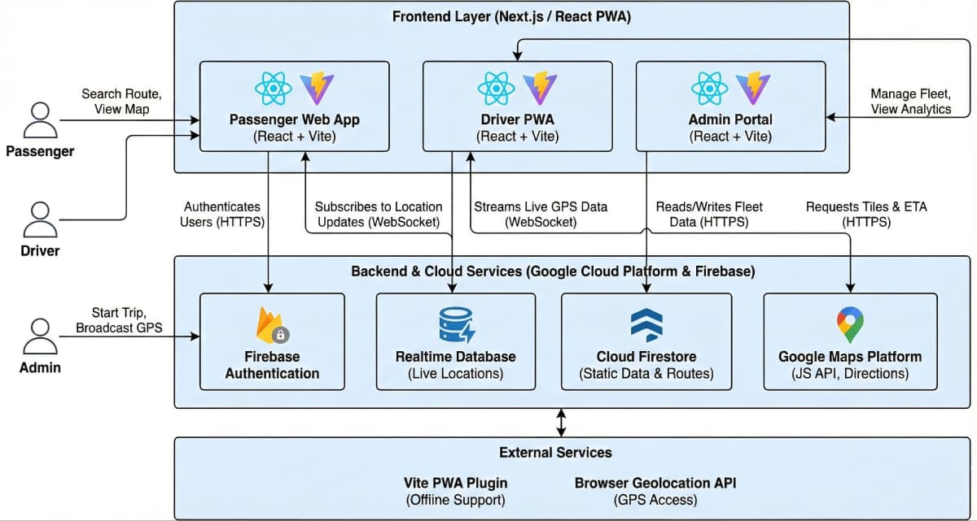
System Level Architecture

Slide 24
07
Sequence Logic & Synchronization

Slide 25
Sequence Logic
Driver logs into the system and starts a trip.
GPS module captures the bus’s current location.
Location data is sent to the backend database.
Backend processes and stores the updated data.
Passenger and Admin request live bus information.
System retrieves latest data and displays it on the map

Slide 26
Synchronization
Real-time GPS data is synchronized using Firebase Realtime Database.
Multiple users receive updated bus location simultaneously.
Backend automatically broadcasts location changes.
System ensures consistency between driver, passenger, and admin views.
Timestamped updates prevent outdated information from being displayed.

Slide 27
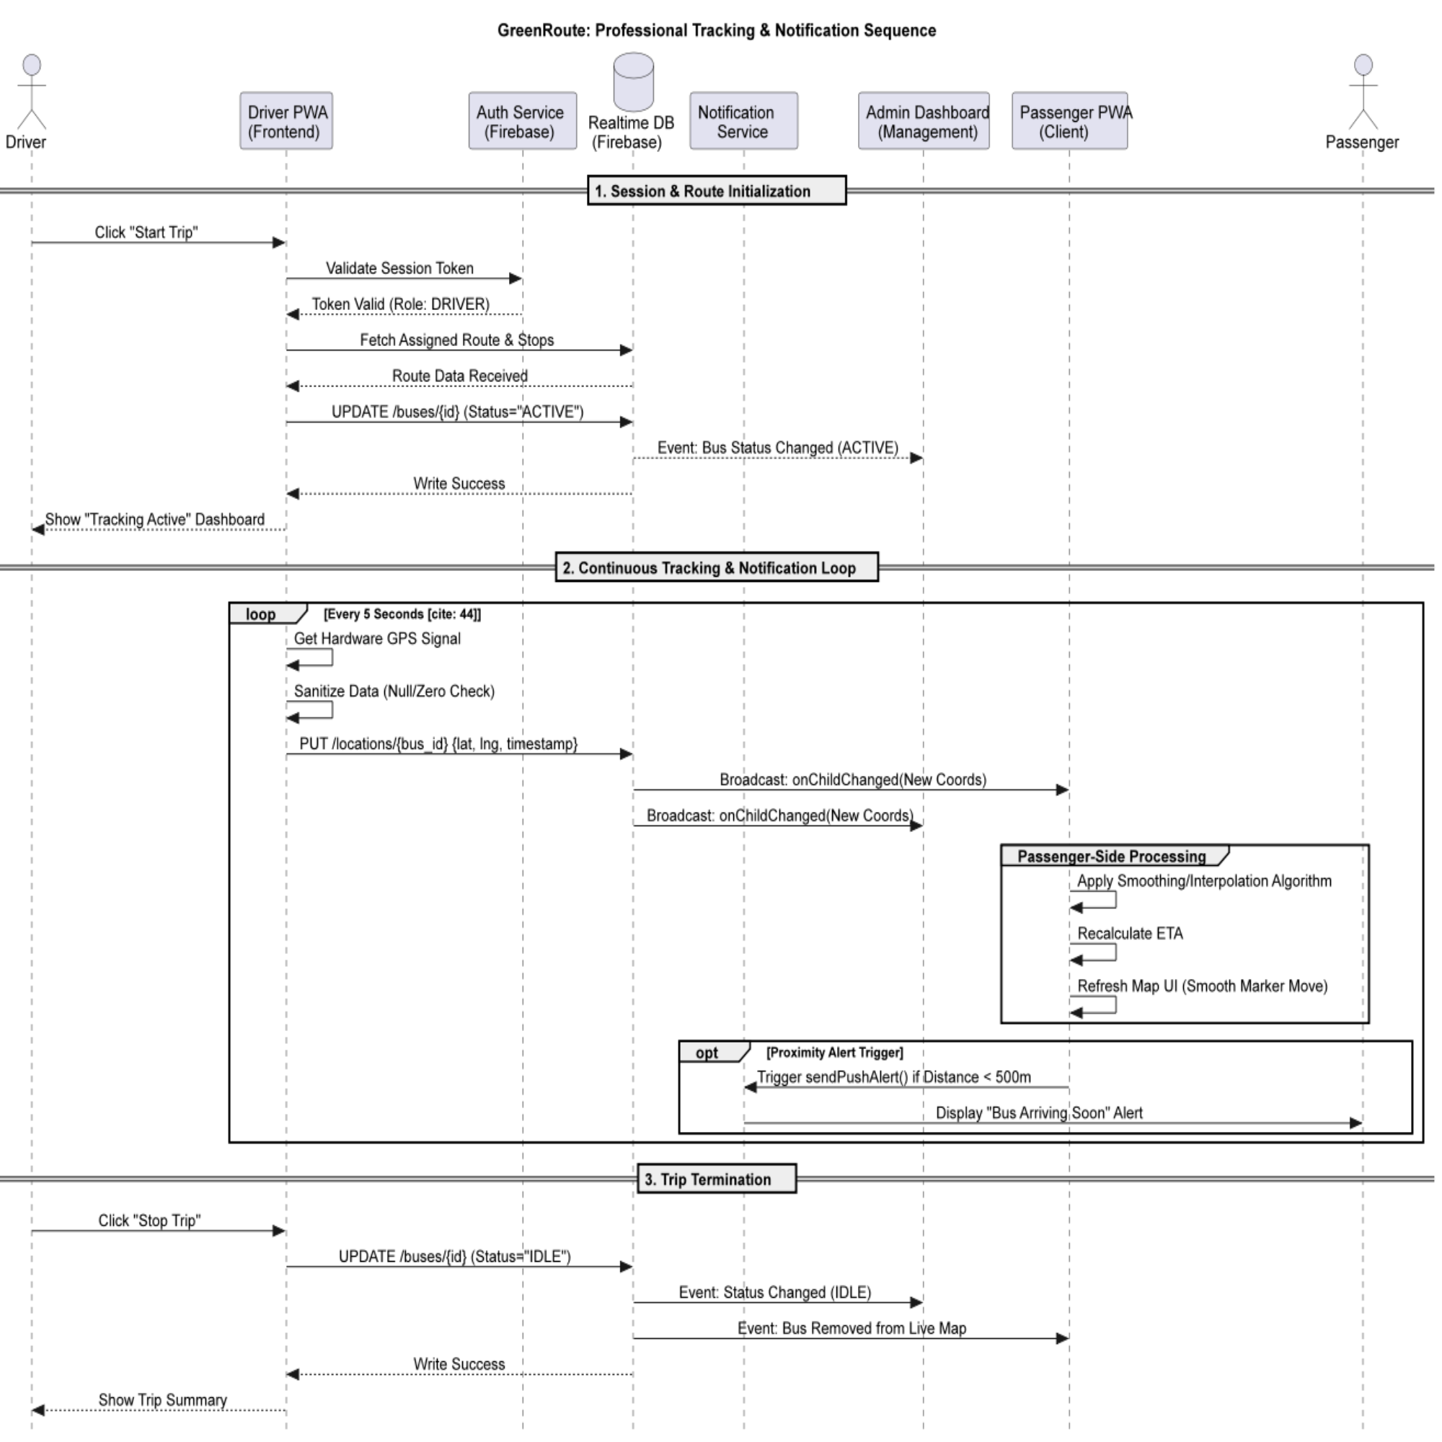
Seqence Diagram
Link to view this sequence diagram clearly: Sequence Diagram

Slide 28
08
Technical Risk & Mitigation

Slide 29
Technical Risks & Mitigation
1.GPS Inaccuracy or Signal Loss:
Risk: Weak GPS signals may cause incorrect or delayed bus location updates.
Mitigation: Use frequent location updates and display last-updated timestamps to inform users.
2. Internet Connectivity Issues:
Risk: Poor or unstable internet may interrupt real-time data transmission.
Mitigation: Automatically resume data synchronization when the connection is restored.

Slide 30
Technical Risks & Mitigation
3. Firebase / Google Maps API Limitations:
Risk: Free-tier API usage limits may cause service interruptions or performance issues.
Mitigation: Optimize data transmission and minimize unnecessary API requests.
4. Real-Time Synchronization Delay:
Risk: Delay between GPS data upload and display may affect tracking accuracy.
Mitigation: Use Firebase real-time listeners for instant data updates across clients.

Slide 31
Technical Risks & Mitigation
5. Data Security Breaches:
Risk: Unauthorized access to sensitive user or driver data.
Mitigation: Enforce HTTPS, Firebase Authentication, and role-based access control (RBAC).
6. System Scalability Issues:
Risk: Increased users may degrade system performance.
Mitigation: Use cloud-based backend (Firebase) to support scalable real-time operations.

Slide 32
Technical Risks & Mitigation
7. Driver Device Battery Drain:
Risk: Continuous GPS tracking may drain driver’s mobile battery.
Mitigation: Use lightweight tracking logic and stop GPS updates automatically after trip completion.
8. Data Loss or System Failure:
Risk: Server or system failure may result in data loss.
Mitigation: Implement backup and recovery mechanisms within the cloud database.

Slide 33
Technology Stack
09

Slide 34
Technologies Used
Frontend:
React.js for building a responsive user interface.
Progressive Web Application (PWA) for cross-platform accessibility.
Works smoothly on mobile and desktop browsers.
Backend:
Firebase Realtime Database for live data synchronization.
Firebase Authentication for secure user login and role management.
Cloud-based backend ensures scalability and reliability.

Slide 35
Technologies Used
APIs & Services:
Google Maps API for live map rendering and route visualization.
GPS services for real-time location tracking.
Development Tools:
JavaScript as the core programming language.
Web browsers for testing and deployment.
Cloud services for hosting and real-time operation

Slide 36
10
User Interface Mockups

Slide 37
User Interface
UI mockups represent the visual design of the system for different user roles.
The system provides role-based interfaces for Passenger, Driver, and Admin.
Interfaces are designed to be simple, responsive, and user-friendly.
Real-time updates are reflected on the UI without page refresh.
The design supports both mobile and desktop browsers using PWA principles.

Slide 38
User Interface
UI mockups represent the visual design of the system for different user roles.
The system provides role-based interfaces for Passenger, Driver, and Admin.
Interfaces are designed to be simple, responsive, and user-friendly.
Real-time updates are reflected on the UI without page refresh.
The design supports both mobile and desktop browsers using PWA principles.

Slide 39
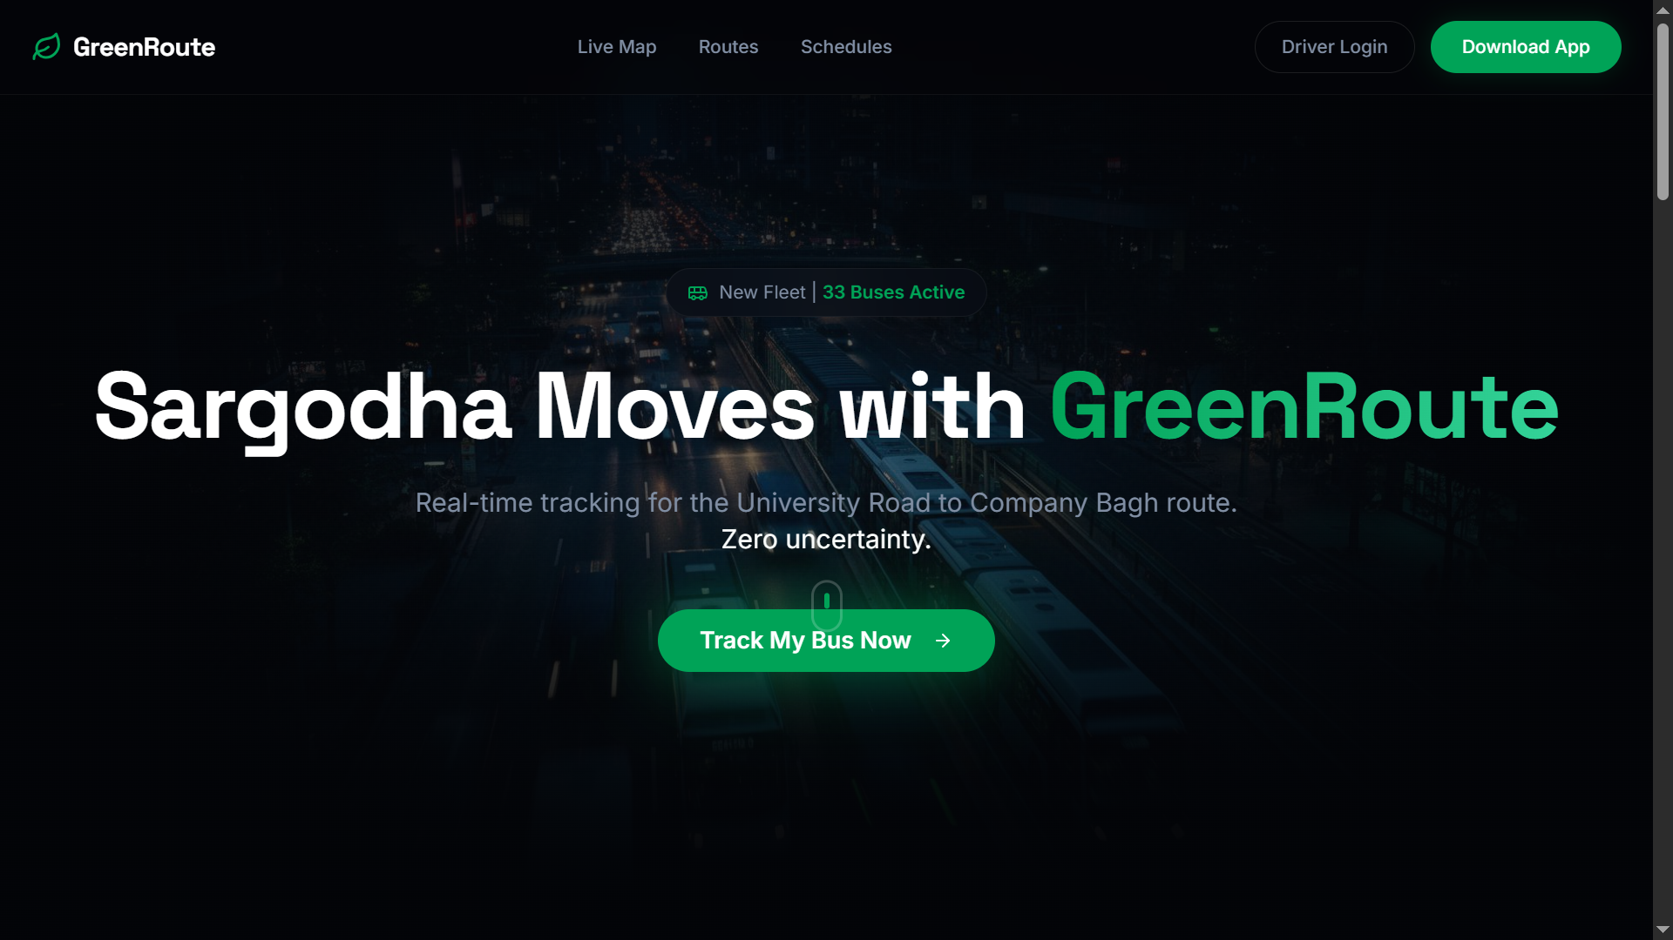
User Interface Mockups
Vercel hosted web app UI mockup: https://greenroutesargodhapk.vercel.app/

Slide 40
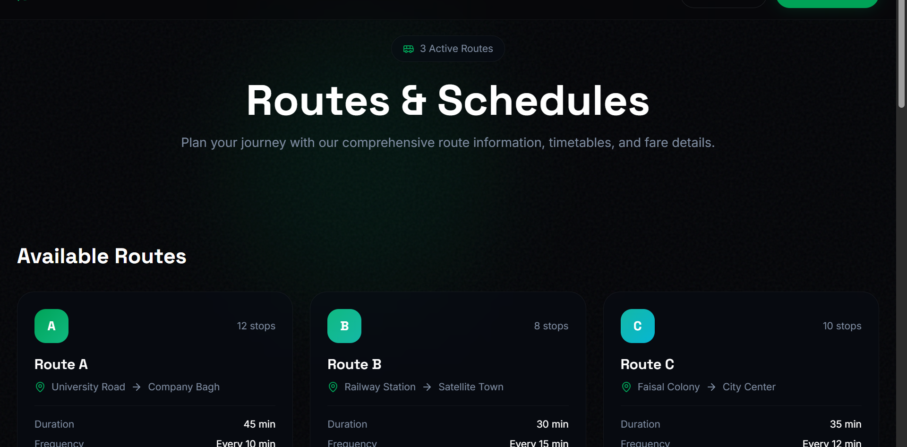
User Interface Mockups

Slide 41
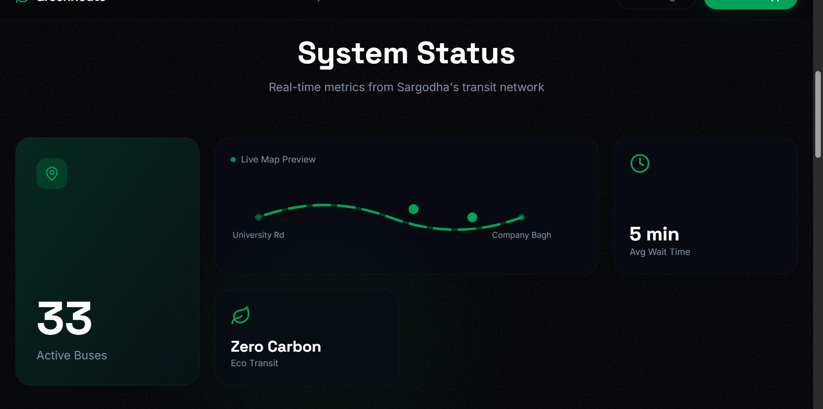
User Interface Mockups

Slide 42
11
Conclusion & Future Roadmap

Slide 43
Conclusion
GreenRoute is not just a tracking app; it is a foundational platform for the digital transformation of Sargodha's transport.
Digital Transformation: GreenRoute successfully bridges the visibility gap in Sargodha's transit system, replacing manual guesswork with data-driven certainty.
Operational Efficiency: Delivers a sub-second latency tracking experience using standard smartphones, eliminating the need for expensive hardware trackers.
Scalability: The Serverless Architecture is ready to scale from 33 buses to 500+ without code modification.

Slide 44
Future Scope
AI Integration: Utilizing historical route data to predict traffic delays and optimize schedules.
Smart Ticketing: Implementation of QR-Code/NFC based digital payments to remove cash handling.
Native Ecosystem: Transitioning the PWA into fully offline-capable Android & iOS applications.

Slide 45
THANKS! We are now open for Questions.

